Slide 1

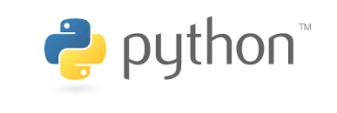
Introduction to Python – Block 3 Week 1
Mark Smith

Slide 2
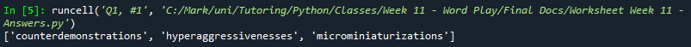
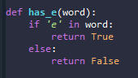
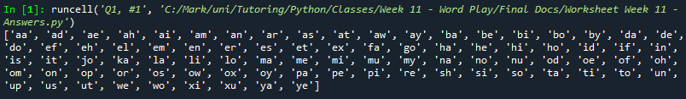
Last Week
How to look at every word possible
How to find certain words

Slide 3
This Week – Variables and functions
Today we will learn:
What is a Jupyter Notebook
Warmup from last week – All the words in English
A different way to look at variables
A different way to look at functions
Notes:
Go To exercise Notebook now for the Introduction and Warmup Sections

Slide 4
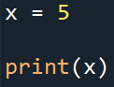
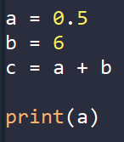
Variables
What would this code do?
Notes:
Ask them first if you have already done some material like this

Slide 5
Variables
What would this code do?
Notes:
Explain

Slide 6
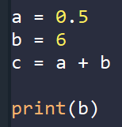
Variables
What would this code do?
Notes:
Explain

Slide 7
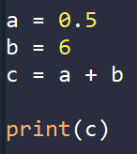
Variables
What would this code do?
Notes:
Explain

Slide 8
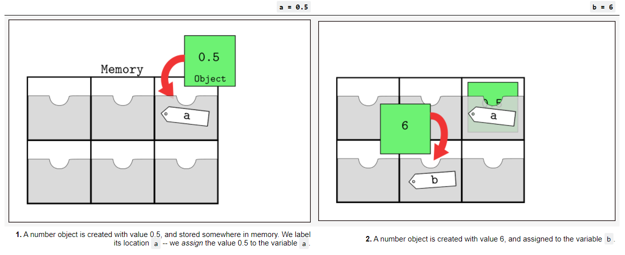
Variables
Python Programming – Charlotte Desvages – University of Edinburgh
Notes:
Explain

Slide 9
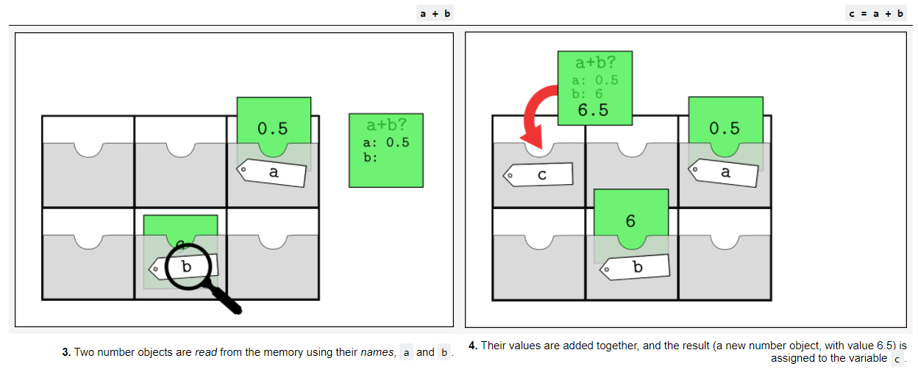
Variables
Python Programming – Charlotte Desvages – University of Edinburgh
Notes:
Explain

Slide 10
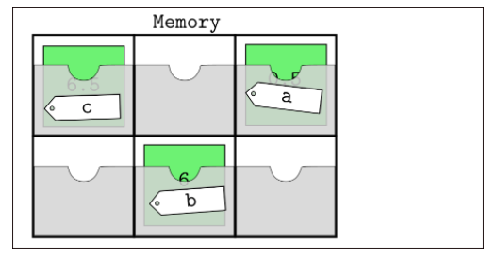
Variables
Python Programming – Charlotte Desvages – University of Edinburgh
Notes:
Explain

Slide 11
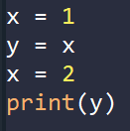
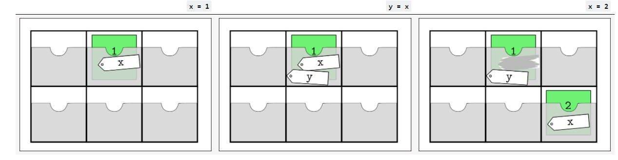
Variables
Python Programming – Charlotte Desvages – University of Edinburgh
Notes:
Explain then go to worksheet

Slide 12
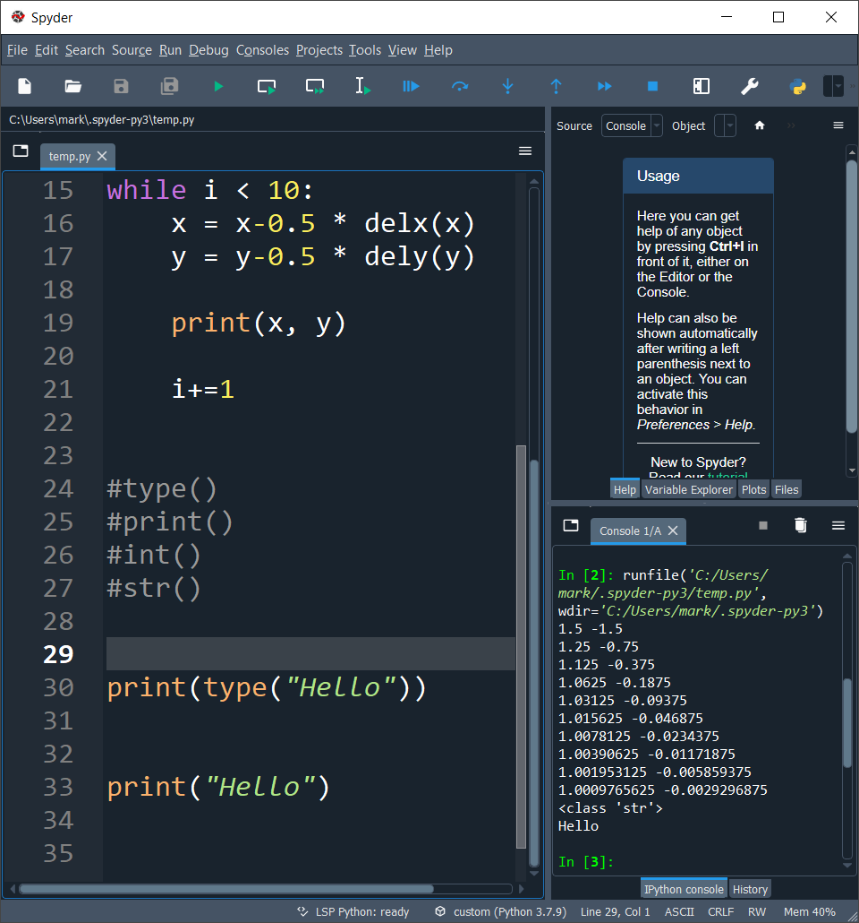
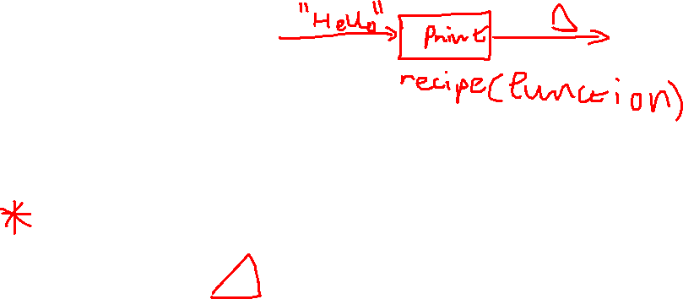
functions
A function is a named sequence of statements that performs a computation or calculation which we first define and later call by name. Functions have:
Argument
Return Value
Notes:
Explain this and the drawing. Emphasise defining and calling

Slide 13
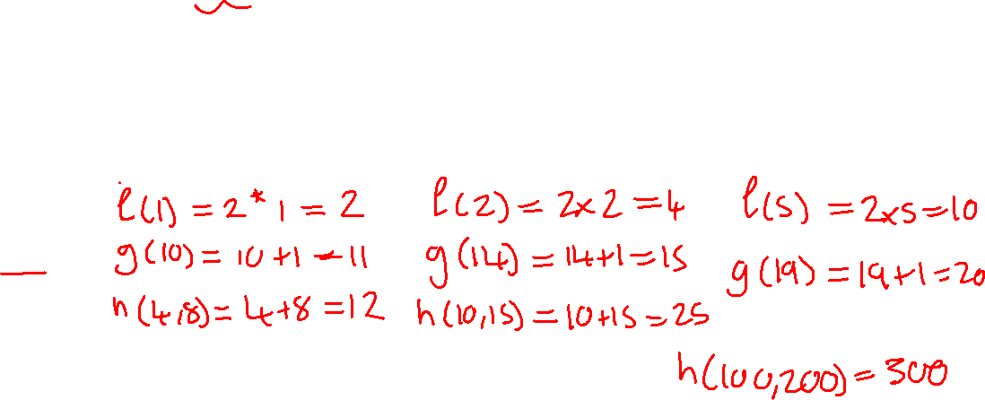
functions
Functions are used very often in mathematics and as we have seen are very useful in programming, allowing us to do the same action very quickly over and over again. Let’s look at some functions in mathematics:
f(x) = 2*x
g(x) = x + 1
h(x, y) = x + y
Find f(1), f(2), f(5)
Find g(10), g(14), g(19)
Find h(4, 8), h(10, 15), h(100, 200)
Notes:
Explain all of these yourself, draw on the slide

Slide 14
functions
Now it is over to you, let’s do some exercises on functions like this!
Notes:
Go to worksheet and ask for answers to each of these questions in the functions section

Slide 15
functions
Now let us write these functions in Python!
Notes:
Go to the worksheet and show yourself making these functions

Slide 16
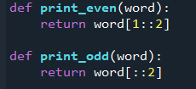
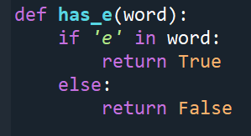
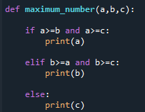
functions
This is exactly how all the functions work that we have used so far, instead of returning numbers they return other values.

Slide 17
End of class
This week we have looked at:
How to think about storing variables
How the computer stores these variables in memory
What are functions
How do we write mathematical functions

